Slide 1



MACHINE LEARNING BASED WEBAPP IMPLEMENTATION TO PREDICT INDIAN INFLATION RATE
Presented By :
CHESHTA,KUNAL,NIDHI,NIKHIL
Under The Guidance Of:
Ms. Astha Goyal

Slide 2
AIM
IMPLEMENTATION OF MACHINE LEARNING MODELS THROUGH FLASK REST API TO PREDICT INDIAN INFLATION RATE USING PYTHON OSL(OPEN SOURCE LICENSE)
BY COMPARATIVE STUDY OF THE POTENTIAL OF MACHINE LEARNING MODELS
Let’s Start the Presentation!
PROJECT OBJECTIVE
ARTIFICIAL NEURAL NETWORKS (ANN)
K-NEIGHBORS
DECISION TREES
RANDOM FORESTS.

Slide 3
WHAT ARE WE GOING TO LEARN!
CONTENTS
MACHINE LEARNING DEMISTYFIED: WHY AND WHERE ML IS APPLIED
TYPES OF LEARNING
DATA AND FEATURE EXTRACTION USING PANDAS
MACHINE LEARNING MODELS
FLASK WEB APP IMPLEMENTATION
HOW TO CODE ML PROBLEMS USING PYTHON (SKLEARN)
CROSS VALIDATION AND TRAIN TEST SPLIT
MODEL EVALUATION METRICES
PRINCIPLE COMPONENT ANALYSIS (PCA)
PREDICTION OF INFLATION INDEX- MULTIPLE REGRESSION USING ML
REFRENCES

Slide 4
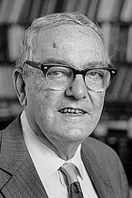
MACHINE LEARNING
HERBERT ALEXANDER SIMON: “LEARNING IS ANY PROCESS BY WHICH A SYSTEM IMPROVES PERFORMANCE FROM EXPERIENCE.”
“MACHINE LEARNING IS CONCERNED WITH COMPUTER PROGRAMS THAT AUTOMATICALLY IMPROVE THEIR PERFORMANCE THROUGH EXPERIENCE. “
HERBERT SIMON
TURING AWARD 1975 NOBEL PRIZE IN ECONOMICS 1978

Slide 5
WHY MACHINE LEARNING ?
Develop systems that can automatically adapt and customize themselves to individual users.
→ Personalized news or mail filter
Discover new knowledge from large databases (data mining).
→ Market basket analysis (e.g. diapers and beer)
Ability to mimic human and replace certain monotonous tasks - which require some intelligence.
→Like recognizing handwritten characters
Develop systems that are too difficult/expensive to construct manually because they require specific detailed skills or knowledge tuned to a specific task (knowledge engineering bottleneck).

Slide 6
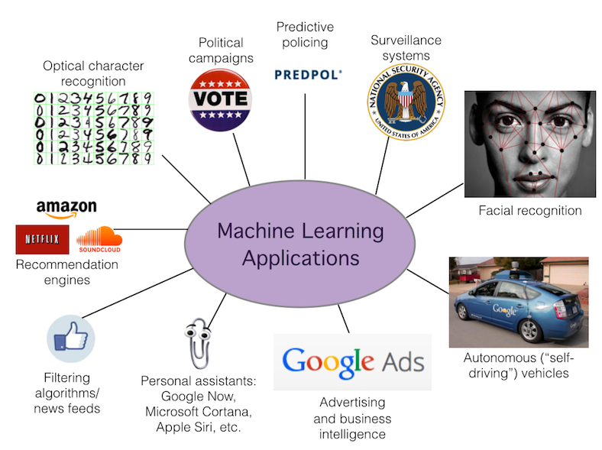

Slide 7
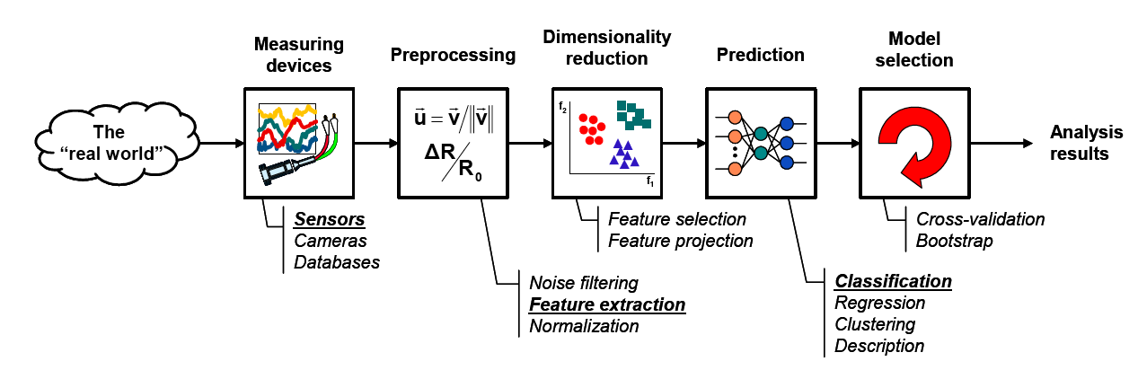
THE LEARNING PROCESS

Slide 8
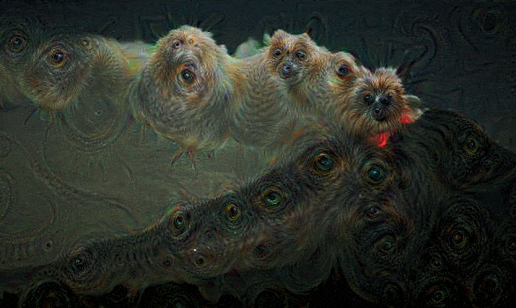

Slide 9
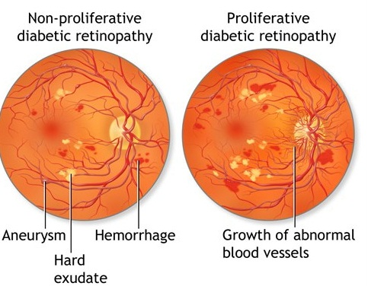

Slide 10
Supervised learning
Unsupervised learning
Reinforcement learning
TYPES

Slide 11
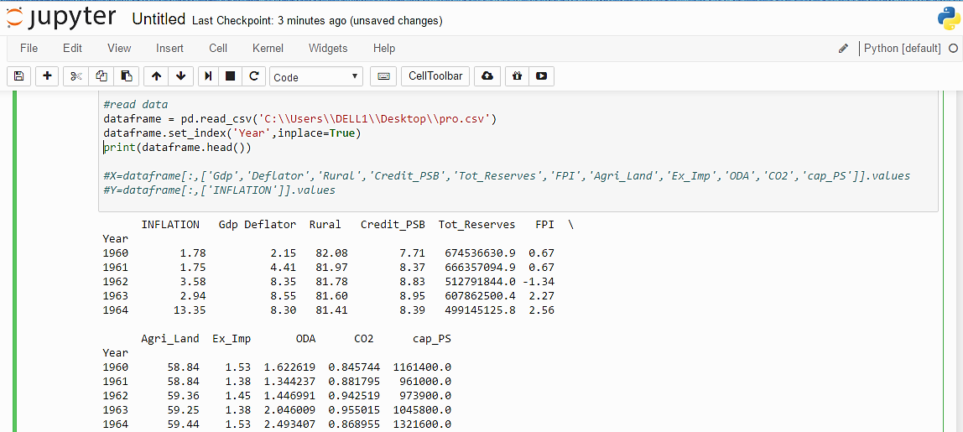
DATAFRAME

Slide 12
MACHINE LEARNING MODELS
NEURAL NETWORKS
KNEIGHBOURS
DECISION TREES
RANDOM FORESTS

Slide 13
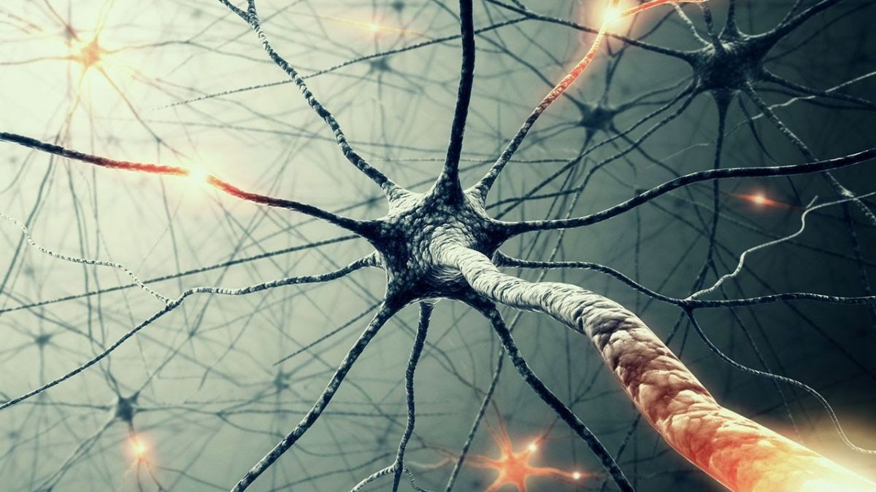
NEURAL NETWORKS

Slide 14
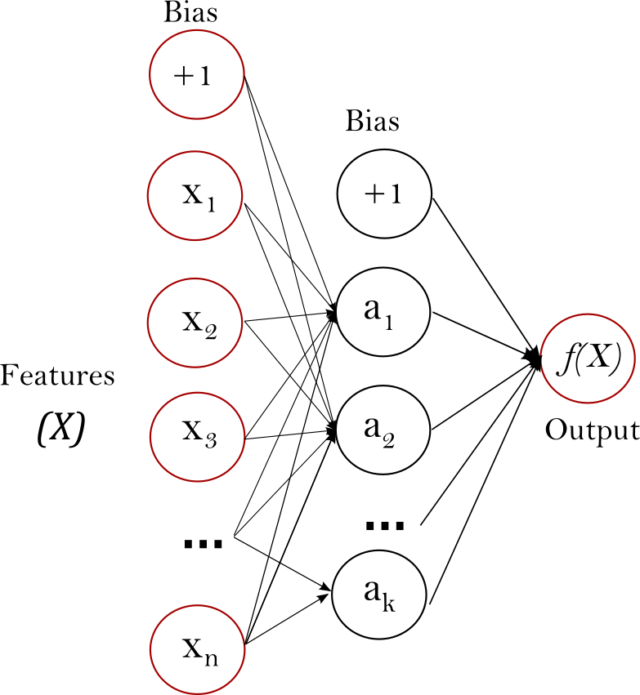
NEURAL NETWORK
Multi-layer Perceptron (MLP) is a supervised learning algorithm that learns a function
by training on a dataset,
Given a set of features and a target y ,learns a non-linear function approximator for regression.
‘UNIVERSAL APPROXIMATOR’
In between the input and the output layer, there can be one or more non-linear layers, called hidden layers. Figure .shows a one hidden layer MLP with scalar output.

Slide 15
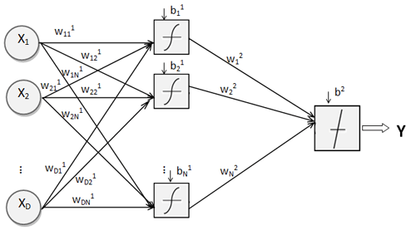
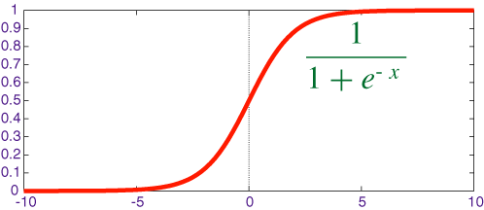
BACKPROPOGATION

Slide 16
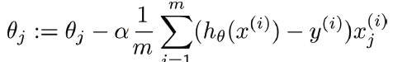

STOCHASTIC GRADIENT DESCENT ANIMATION FOR ERROR

Slide 17
ADVANTAGES & DISADVANTAGES
The advantages of Multi-layer Perceptron are:
Capability to learn non-linear models.
Capability to learn models in real-time (on-line learning)
The disadvantages of Multi-layer Perceptron (MLP) include:
MLP with hidden layers have a non-convex loss function where there exists more than one local minimum. Therefore different random weight initializations can lead to different validation accuracy.
MLP requires tuning a number of hyper parameters such as the number of hidden neurons, layers, and iterations.
MLP is sensitive to feature scaling.

Slide 18
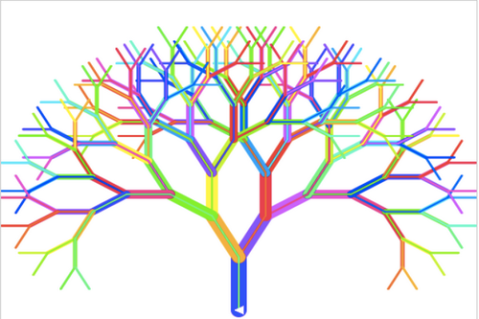

RANDOM FORESTS & DECISION TREES

Slide 19
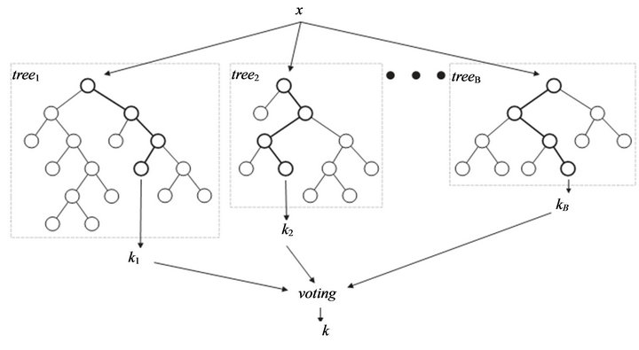
RELATIONSHIP
Random forest (or random forests) is an ensemble classifier that consists of many decision trees and outputs the class that is the mode of the class's output by individual trees.
Decision Trees (DTs) are supervised learning method used for classification and regression. The goal is to create a model that predicts the value of a target variable by learning simple decision rules inferred from the data features.

Slide 20
ADVANTAGES
THE ADVANTAGES OF RANDOM FOREST ARE:
It is one of the most accurate learning algorithms available. for many data sets, it produces a highly accurate classifier.
runs efficiently on large databases.
can handle thousands of input variables without variable deletion.
has an effective method for estimating missing data and maintains accuracy when a large proportion of the data are missing.

Slide 21
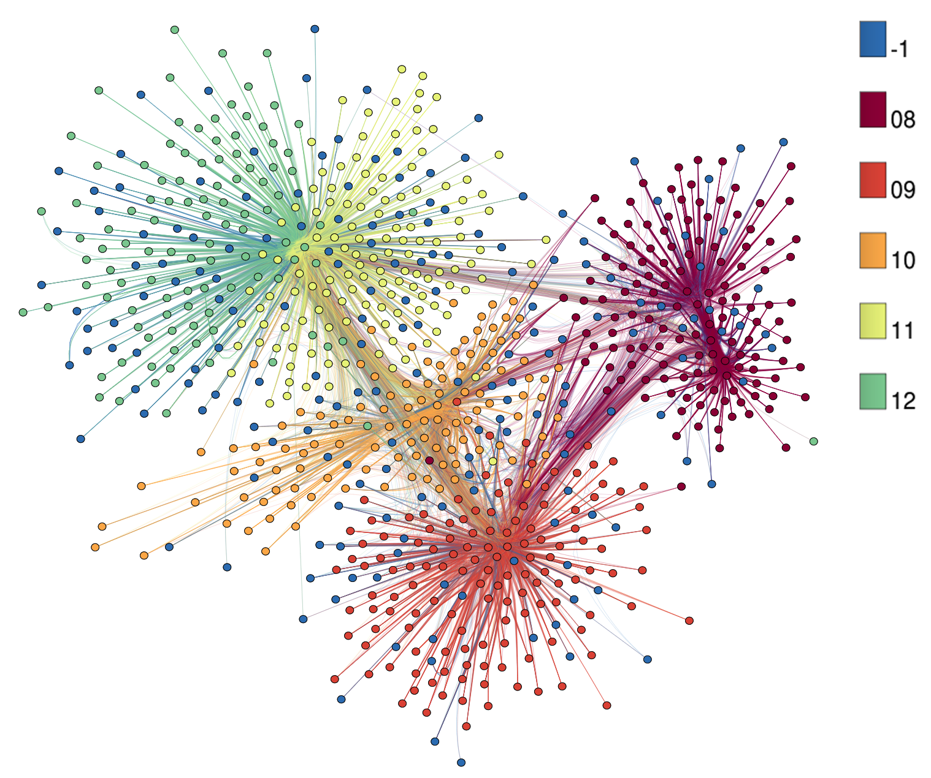
K NEAREST NEIGHBOURS

Slide 22
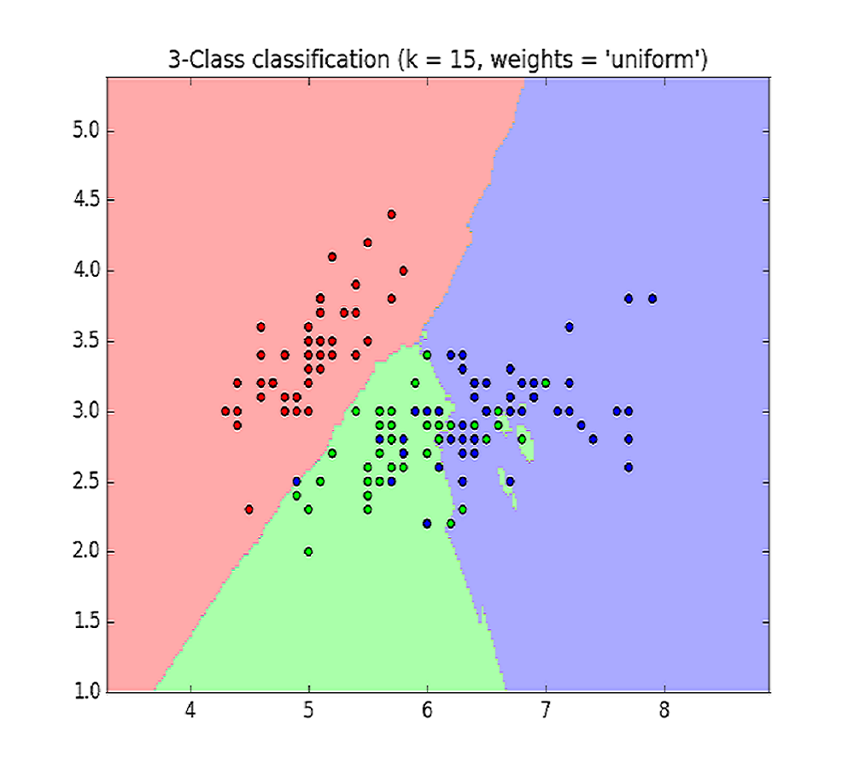
PRINCIPLE
The principle behind nearest neighbor methods is to find a predefined number of training samples closest in distance to the new point, and predict the label from these.
The number of samples can be a user-defined constant (k-nearest neighbor learning), or vary based on the local density of points (radius-based neighbor learning)
metric measure: standard Euclidean distance is the most common choice

Slide 23
PROJECT METHODOLOGY : PYTHON IMPLEMENTATION
FEATURE EXTRACTION – DATAFRAME (PANDAS LIBRARY FUNCTIONS)
MATRIX CONVERSION (NUMPY)
TRAIN TEST SPLIT (SKLEARN)
CROSS VALIDATION (SKLEARN)
GRID SEARCHCV (SKLEARN)
MEAN SQUARED ERROR METRICE (SKLEARN)
PLOT(MATHPLOTIB)
MODEL SAVED (PICKLE)
WEB API MODEL (FLASK)
BOOTSTRAP CSS AND HTML TEMPLATES
LOCAL HOST SERVER AND PREDICTION

Slide 24
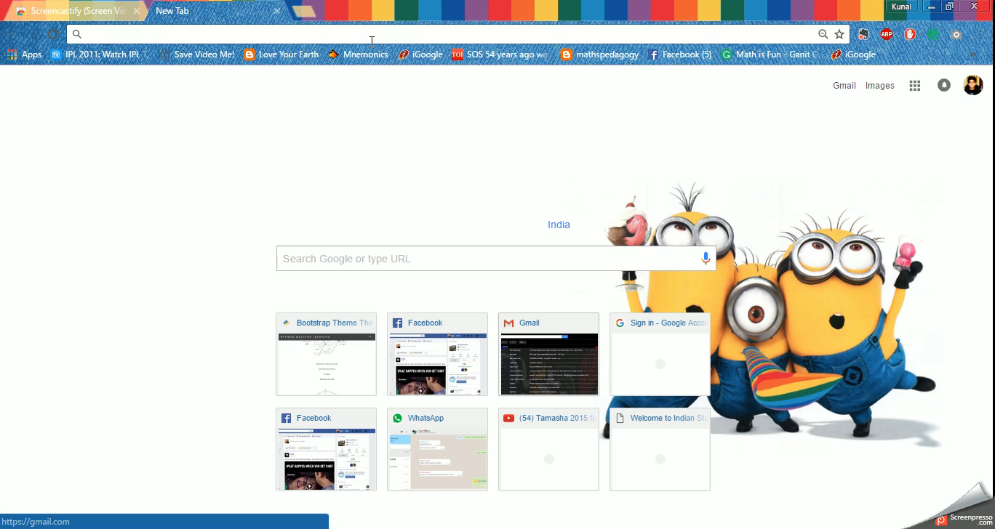
VIDEO OF FLASK REST API :MACHINE LEARNING

Slide 25

WHY PYTHON?
Python is a great general-purpose programming language on its own, but with the help of a few popular libraries (Numpy, Scipy, Matplotlib, Scikit Learn) it becomes a powerful environment for scientific computing.
Machine learning for applications
Ease of use
Light and easy to install package
A general-purpose high level language: Python
High standards
State-of-the-art algorithms
High quality bindings: performance and fine control
Open Source
BSD license
Community driven
SKLEARN

Slide 26
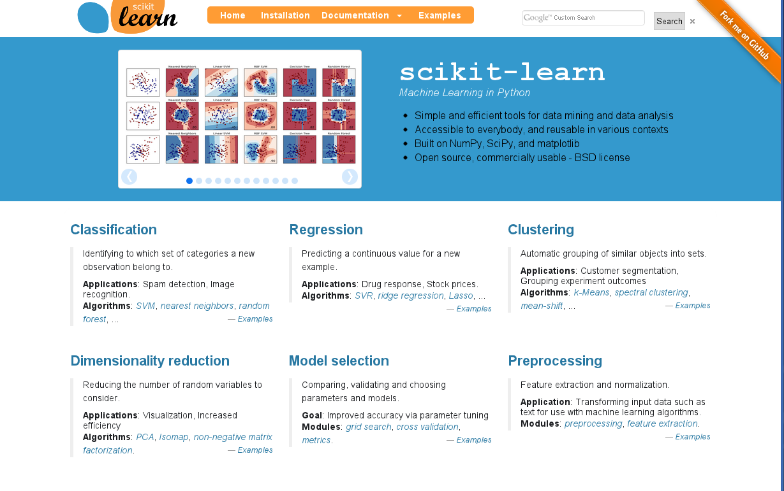

Slide 27

TO
TIME
LEARN
HOW
CODE
TO

Slide 28
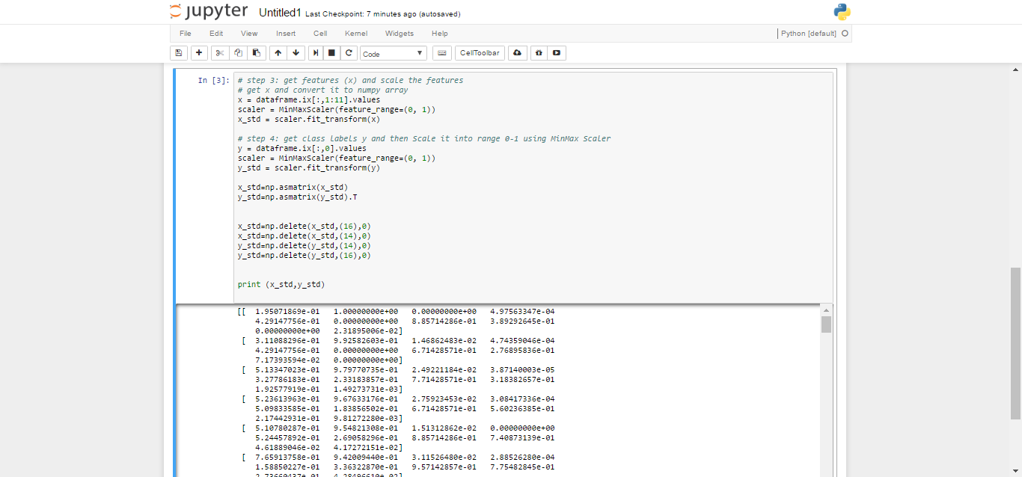
FEATURE SCALING USING MIN MAX SCALER
X_std = (X - X.min)/ (X.max - X.min)

Slide 29
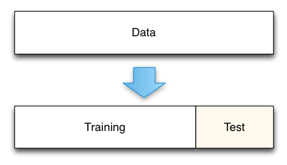
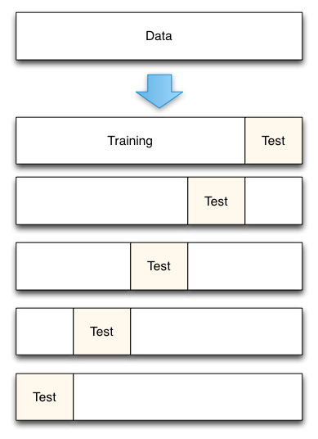
CROSS VALIDATION AND TRAIN TEST SPLITS
a model that would just repeat the labels of the samples that it has just seen would have a perfect score but would fail to predict anything useful on yet-unseen data. This situation is called OVERFITTING.
To counter this Train_Test_Split & CROSS_VALIDATION

Slide 30
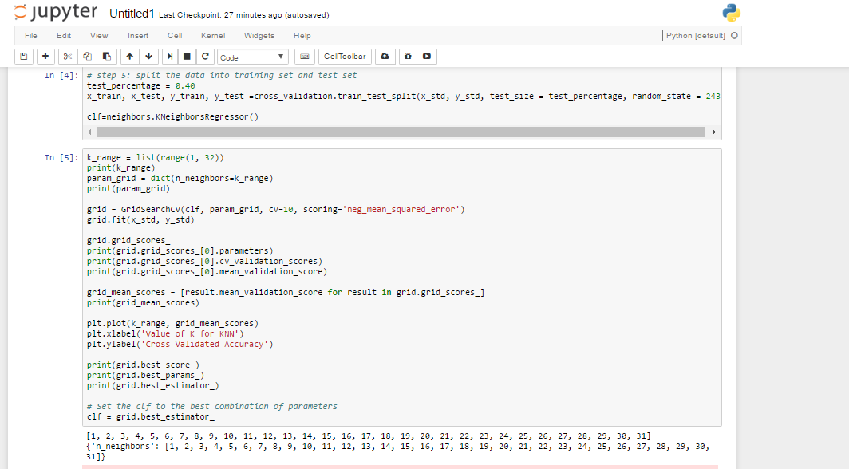
GRID SEARCH CV

Slide 31
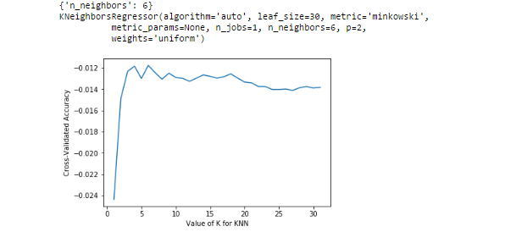
MODEL
EVALUATION

Slide 32
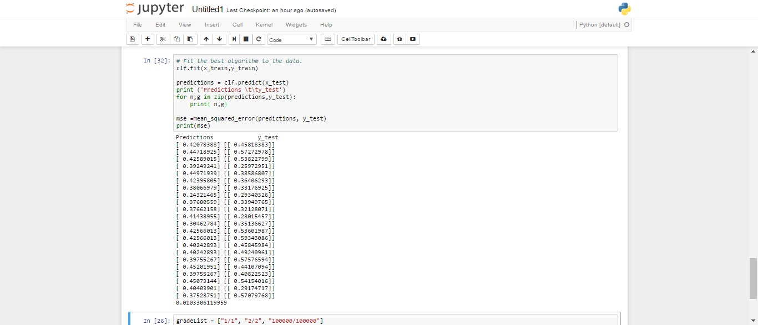
PREDICTION

Slide 33
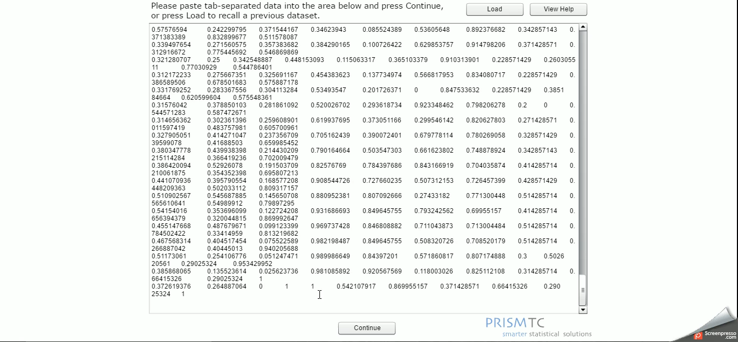
PRINCIPLE COMPONENT ANALYSIS

Slide 34
MODEL COMPARISION
MODEL | MEAN SQUARE ERROR {NORMALIZED} | PERCENTAGE ACCURACY {NORMALIZED}
KN-NEIGHBORS | 0.0103306119959 | 98.96%
NEURAL NETWORK | 0.00987491146601 | 99.01%
RANDOM FOREST | 0.00965674359267 | 99.03%
DECISION TREES {LINEAR MODEL} | 0.0106558262669 | 98.93%

Slide 35
REFRENCES
Neural network versus econometric models in forecasting in action -SAEED MOSHIRI1* AND NORMAN CAMERON2
An artificial neural network for data forecasting purposes cătălina-lucia COCIANU, hakob GRIGORYAN bucharest university of economic studies, bucharest, Romania
Stock price prediction using k-nearest neighbor (knn) algorithm khalid alkhatib1 hassan najadat2 ismail hmeidi 3 mohammed K. Ali shatnawi 4
Estimation, Analysis and Projection of India’s GDP A Time Series Model -U. R Daga, Rituparna Das and Bhishma Maheshwari
“ The excellent Machine Learning ppt ” -Pedro DomingosUniversity of Washington
https://matplotlib.org/contents.html
http://scikit-learn.org/stable/documentation.html
http://scott.fortmann-roe.com/docs/MeasuringError.html
NO FREE HUNCH – http://blog.kaggle.com/
https://www.youtube.com/user/dataschool/featured

Slide 36
PRESENTATION TEAM
CHESHTA SONI (3185)
KUNAL DARGAN(3152)
NIDHI SAKARWAL(3070)
NIKHIL GUPTA ((3157)
THANKYOU ☺

